Slide 1

Web-Based Data Dashboard & API Integration
A centralized interface for visualizing sales, server performance, user demographics, and real-time currency exchange rates
Umarjon Mansurjonov 68921

Slide 2
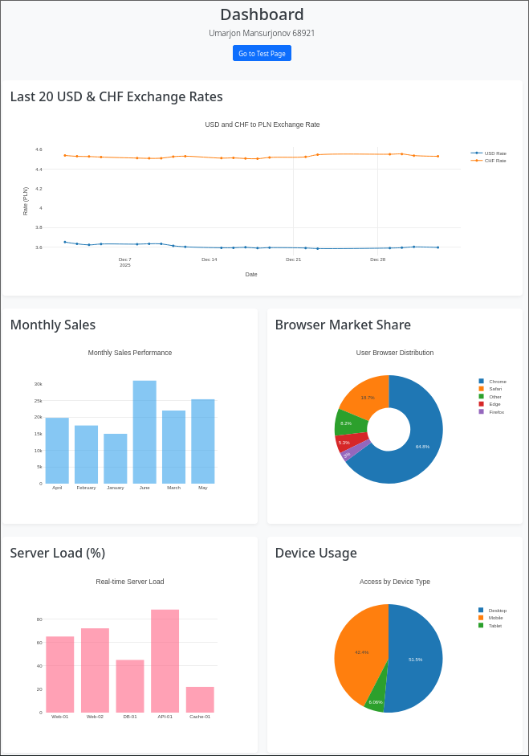
Objectives
Goal: Develop application to retrieve, process, and visualize data from internal and external sources
Key Features:
Data Visualization: Four distinct interactive charts (Sales, Browser Share, Server Load, Device Usage)
External Integration: Real-time fetching of USD and CHF exchange rates against PLN
Architecture: Separation of concerns using a REST-style API layer for internal data

Slide 3
Technology Stack
Backend: PHP 8.1 running on Apache server
Database: MySQL hosted on AwardSpace (Remote connection)
Frontend: HTML5, Bootstrap 5.3.3 for responsive layout
Visualization: Plotly.js for rendering dynamic charts
Containerization: Docker for environment consistency

Slide 4
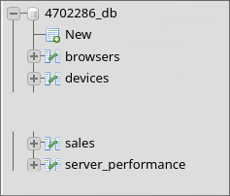
Database Design
The solution utilizes a relational database with four primary tables:
sales: Stores monthly financial performance
browsers: Tracks market share percentages of web browsers
server_performance: Monitors CPU load across different servers
devices: Categorizes user access by device type (Desktop, Mobile, Tablet)

Slide 5
API Implementation
The application exposes data through specific PHP endpoints acting as a REST API
api_sales.php: Returns JSON formatted sales data
api_users.php: Returns browser statistics
api_performance.php: Returns server load metrics
api_devices.php: Returns device usage statistics
Each script executes a SQL query, fetches results into an array, and outputs a JSON object containing labels and values

Slide 6
External API Integration
Source - National Bank of Poland (NBP) API
The system uses PHP cURL to fetch the last 20 exchange rates for USD and CHF
Data Processing:
The fetchData function handles the HTTP request and JSON decoding
Data is parsed to extract effectiveDate and mid (average rate)
Weak Point: The code assumes that the dates for USD and CHF align perfectly without explicit validation or error handling if one dataset is missing dates

Slide 7
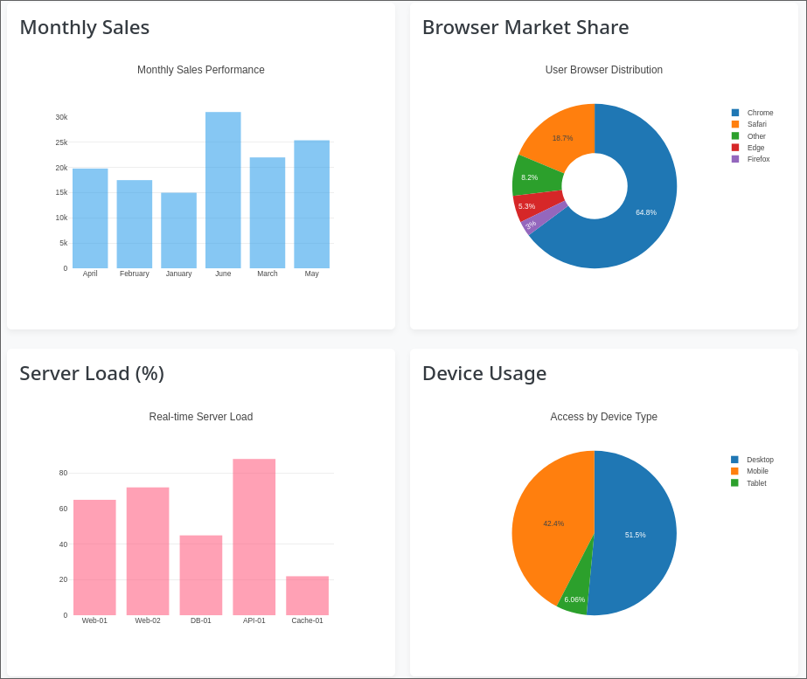
Frontend
A responsive grid system using Bootstrap to display charts side-by-side
Currency: Line chart (scatter type) comparing USD and CHF trends
Sales: Bar chart showing monthly revenue
User/Device: Pie charts showing distribution percentages
Server: Bar chart indicating CPU load per server
PHP injects the fetched JSON data directly into the JavaScript variables

Slide 8

Deployment
The application is containerized using a Dockerfile (to be a friend with render.com)
Eliminates "works on my machine" issues by standardizing the server environment
Additional environment variables and secrets can be further specified for best security practices

Slide 9
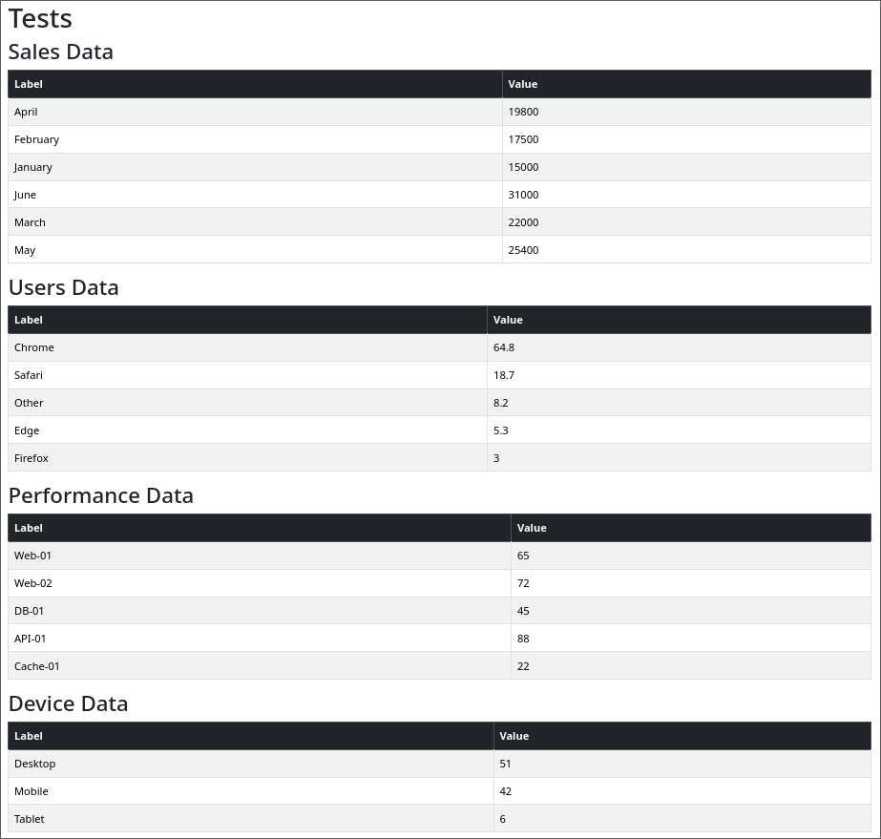
Testing
Manual verification of data integrity via test.php
The test script re-fetches data from all internal APIs
displayDataAsTable function renders raw JSON data into HTML tables for human inspection
The testing is purely observational. There are no automated assertions, unit tests, or edge-case handling (e.g. API failure)

Slide 10
Conclusion
The project successfully demonstrates a full data pipeline: Database → Internal API → Frontend Aggregation → Visualization
Functional integration of different data sources (SQL + NBP API)
Visual representation using modern charting libraries
Containerized deployment capability
The application meets the requirement of displaying stored data but lacks interactive filtering or robust automated testing.

